Slide 1
Working of an acid buffer
Wei MEi

Slide 2
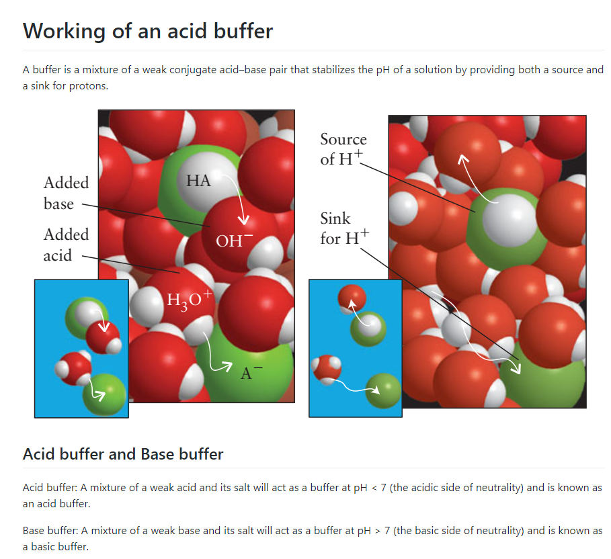
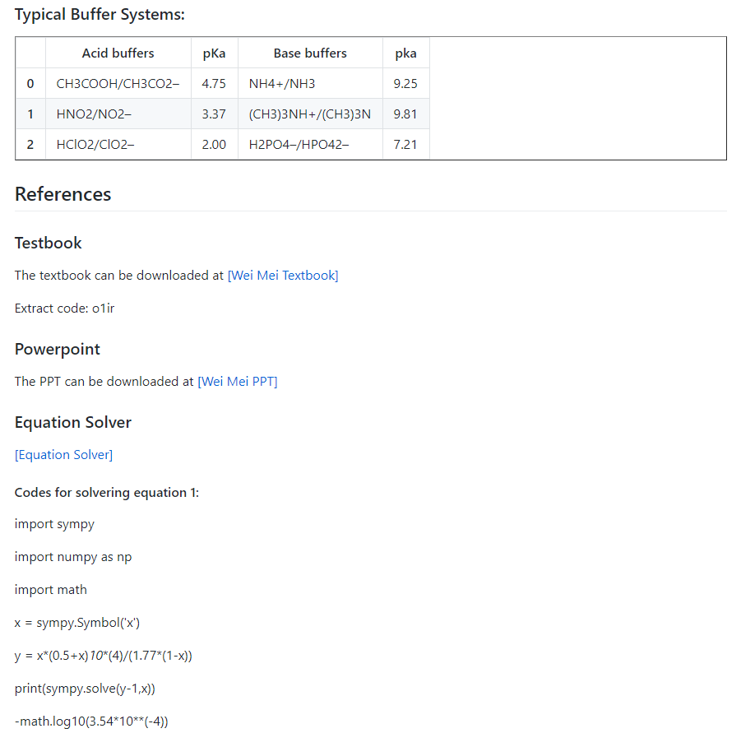
LeCture Website
https://github.com/nickcafferry/Working-of-an-acid-buffer/blob/master/README.md

Slide 3
Buffers
Definition: a solution in which the pH resists change when small amounts of strong acids or bases are added.
Acid buffer: A mixture of a weak acid and its salt will act as a buffer at pH < 7 (the acidic side of neutrality) and is known as an acid buffer.
Base buffer: A mixture of a weak base and its salt will act as a buffer at pH > 7 (the basic side of neutrality) and is known as a basic buffer.

Slide 4
Conditions
Weak acid / Weak base – Conjugate to one another
HCOOH/HCOO-
Approximately equal amount – at the same magnitude
Substantial amount – (High concentration) e.g. 1mol/L

Slide 5
Typical Acid buffers and Base buffers
Acid buffers | pKa | Base buffers | pKa
CH3COOH/CH3CO2– | 4.75 | NH4+/NH3 | 9.25
HNO2/NO2– | 3.37 | (CH3)3NH+/(CH3)3N | 9.81
HClO2/ClO2– | 2.00 | H2PO4–/HPO42– | 7.21

Slide 6
Will it work?
Suppose 0.10 mol of a strong acid such as HCl is added to the 1 liter of pure water, calculate the pH of the resulting solution.
pH = 7 → pH = 1
Suppose 0.10 mol of a strong acid such as HCl is added to the 1mol/l HCOOH and 0.5 mol/l HCOONa 1 liter solution (Ka = 1.77 x 10^-4), calculate the pH of the resulting solution.
? → ?

Slide 7
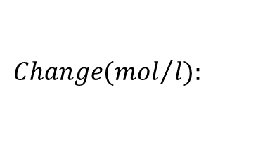



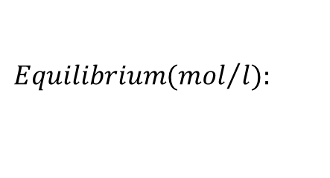

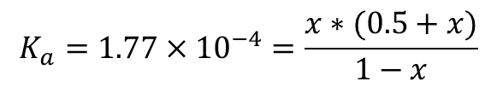








Will it work?
Suppose 0.10 mol of a strong acid such as HCl is added to the 1mol/l HCOOH and 0.5 mol/l HCOONa 1 liter solution (Ka = 1.77 x 10^-4), calculate the pH of the resulting solution.
Before the addition of HCl:
$$HCOOH\left(aq\right)+H_{2}O\left(l\right)↔H_{3}O^{+}\left(aq\right)+HCOO^{−}(aq)$$
$$Initial({mol}/l):$$
$$1$$
$$−$$
$$0$$
$$0.5$$
$$Change({mol}/l):$$
$$−x$$
$$x$$
$$x$$
$$Equilibrium({mol}/l):$$
$$1−x$$
$$x$$
$$0.5+x$$
$$K_{a}=1.77×{10}^{−4}=\frac{x∗(0.5+x)}{1−x}$$
$$x=3.54×{10}^{−4}$$
pH = 3.451

Slide 8


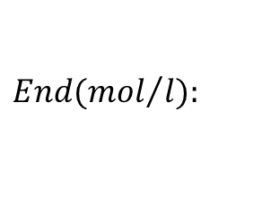

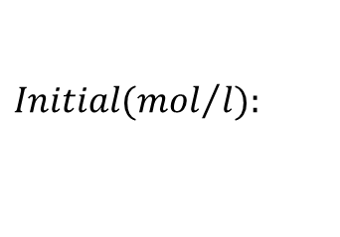





Will it work?
Suppose 0.10 mol of a strong acid such as HCl is added to the 1mol/l HCOOH and 0.5 mol/l HCOONa 1 liter solution (Ka = 1.77 x 10^-4), calculate the pH of the resulting solution.
After the addition of HCl:
$$H_{3}O^{+}\left(aq\right)+HCOO^{−}\left(aq\right)→HCOOH\left(aq\right)+H_{2}O\left(l\right)$$
$$Initial({mol}/l):$$
$$0.1$$
$$0.5$$
$$1$$
$$−$$
$$End({mol}/l):$$
$$0$$
$$0.4$$
$$1.1$$
$$−$$

Slide 9



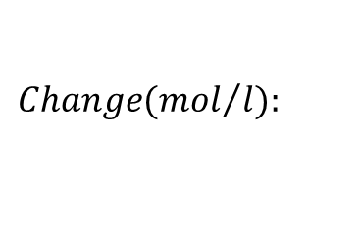




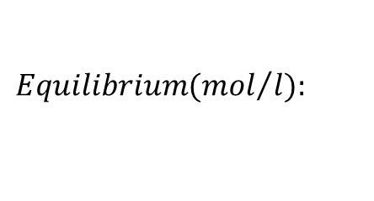

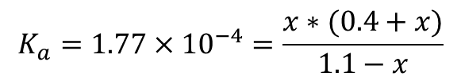




Will it work?
Suppose 0.10 mol of a strong acid such as HCl is added to the 1mol/l HCOOH and 0.5 mol/l HCOONa 1 liter solution (Ka = 1.77 x 10^-4), calculate the pH of the resulting solution.
After the addition of HCl:
$$HCOOH\left(aq\right)+H_{2}O\left(l\right)↔H_{3}O^{+}\left(aq\right)+HCOO^{−}(aq)$$
$$Initial({mol}/l):$$
$$1.1$$
$$−$$
$$0$$
$$0.4$$
$$Change({mol}/l):$$
$$−x$$
$$x$$
$$x$$
$$Equilibrium({mol}/l):$$
$$1.1−x$$
$$x$$
$$0.4+x$$
$$K_{a}=1.77×{10}^{−4}=\frac{x∗(0.4+x)}{1.1−x}$$
$$x=4.86×{10}^{−4}$$
pH = 3.31

Slide 10
Will it work?
it works!
Suppose 0.10 mol of a strong acid such as HCl is added to the 1 liter of pure water, calculate the pH of the resulting solution.
pH = 7 → pH = 1
Suppose 0.10 mol of a strong acid such as HCl is added to the 1mol/l HCOOH and 0.5 mol/l HCOONa 1 liter solution (Ka = 1.77 x 10^-4), calculate the pH of the resulting solution.
pH = 3.451 → pH=3.31

Slide 11
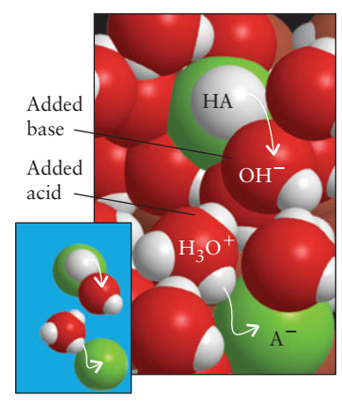
Why?
To understand why, consider the dynamic equilibrium between a weak acid and its conjugate base in water:
$$HA\left(aq\right)+H_{2}O\left(l\right)↔H_{3}O^{+}\left(aq\right)+A^{−}(aq)$$
When a few drops of a strong acid are added to such a solution, the newly arrived H+ ions transfer protons to the A- ions to form HA and H2O molecules.
Because the added H+ ions are removed by the A- ions, the pH remains almost unchanged.
If a small amount of strong base is added instead, the incoming OH- ions remove protons from the HA molecules to produce A- ions and H2O molecules.
Because the added OH- ions are
removed by the HA molecules, the concentration of OH- ions remains nearly unchanged.

Slide 12
Homework 1
Consider the equilibrium:
$$HA\left(aq\right)+H_{2}O\left(l\right)↔H_{3}O^{+}\left(aq\right)+A^{−}(aq)$$
Can you derive the relationship between $K_{a}$ and $pH$ ?
$$Hint: K_{a}=\frac{\left[H_{3}O^{+}\right][A^{−}]}{[HA]}$$

